Slide 1

HCI History & Foundations
Presented by Allen Jue and Temitayo Awosemo

Slide 2
01
Learning Goals

Slide 3
Learning Goals
Why is understanding the history of HCI important?
How was HCI historically studied?
How does HCI’s history shape its present/future?
How do HCI goals change with time?

Slide 4
02
What is HCI?

Slide 5
What is HCI?
What is HCI?
Why do we need this field?

Slide 6
Formally, HCI is…
Human–computer interaction (HCI) is research in the design and the use of computer technology, which focuses on the interfaces between people (users) and computers.
Notes:
So here is a formal definition that we pulled of the internet, but there is a whole lot more to it. And, as we have seen through time and as we will discuss today, humans change, and computers change. So, this definition too also changes.

Slide 7
03
HCI in the Past
Notes:
HCI has a rich history, and to understand why we are even studying this, I think it’s important to take a step back and see how scientific fields like HCI depend on history.

Slide 8
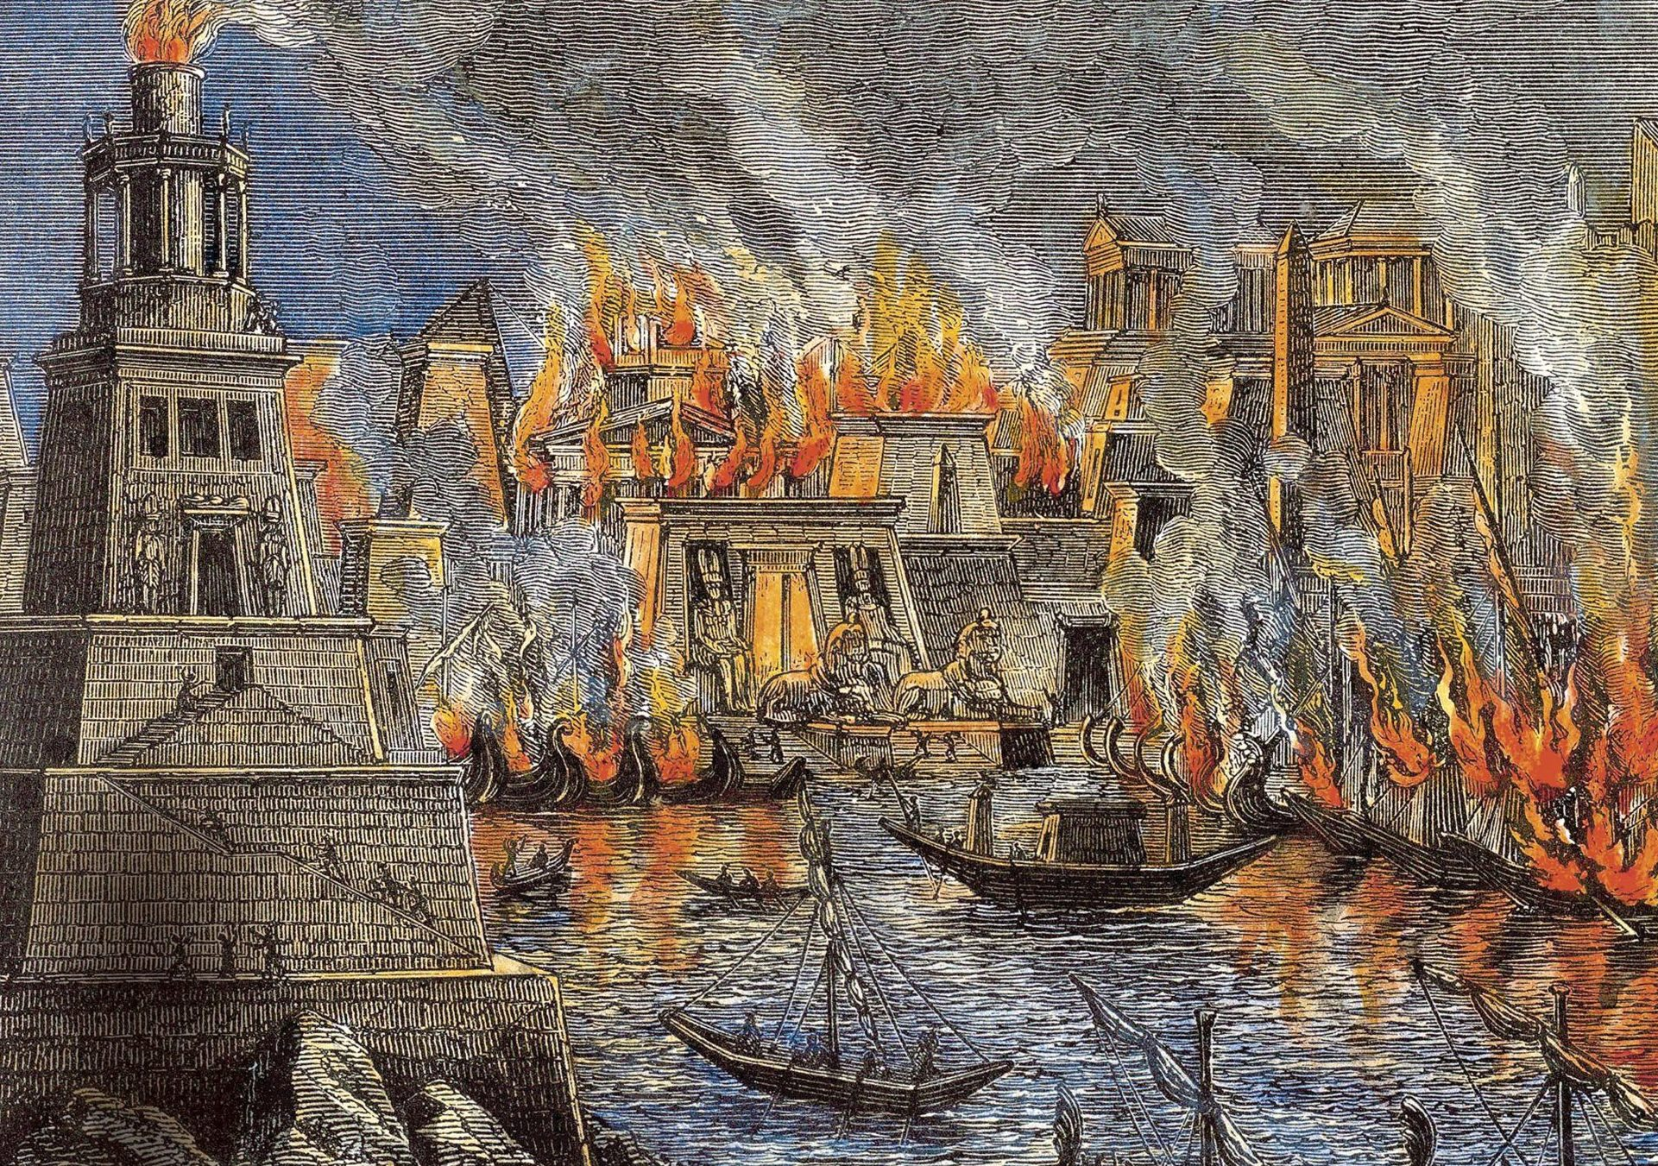
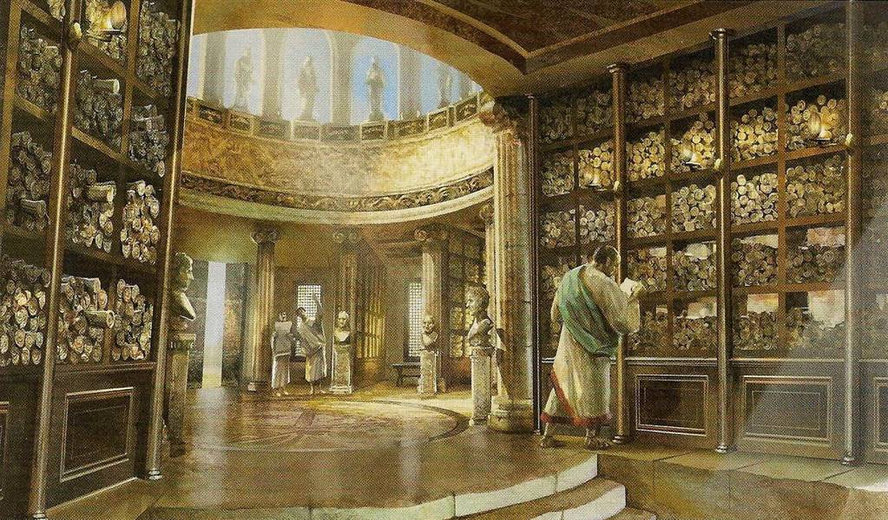
Notes:
When we go way back, we see that humans have spent just about most of modern history recording information and sharing their findings with their peers. This is the Library of Alexandria, one of the first large-scale information hubs for research and scholars. Unfortunately, though, paper isn’t the most persistent form of information storage.

Slide 9
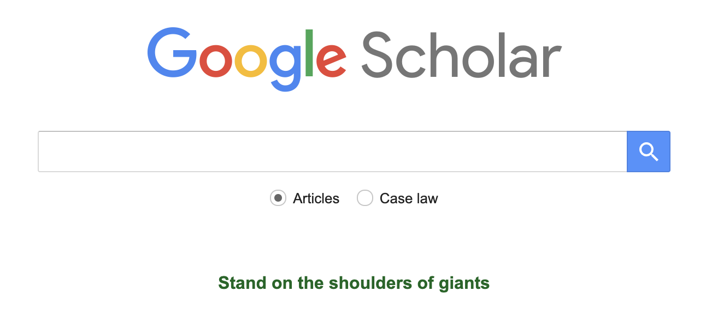
Notes:
Nowadays, we have Google Scholar to help record HCI research and research in general. By looking at ideas of the past, seeing the technologies they were limited by, and uplifting their research with our current technology is a huge part of innovation. This brings me to the quote on the bottom “Stand on the shoulders of giants.” It was a quote by Isaac Newton who humbly said that…

Slide 10
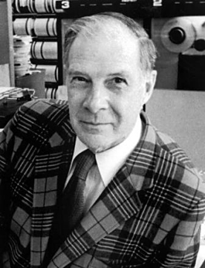
"If I have seen a little farther than others, it is because I have stood on the shoulders of giants."
Indeed, one of my major complaints about the computer field is that whereas Newton could say, "If I have seen a little farther than others, it is because I have stood on the shoulders of giants," I am forced to say, "Today we stand on each other's feet."
- Richard Wesley Hamming
Notes:
Let that sink in a little bit. Is this sentiment of building upon the foundations, history, and innovations of our predecessors coming to a halt? In recent years, the quantity of research papers being published has exploded, but does that mean the number of innovations has exploded as well? That may be subjective, but I do think there is a lot of truth in this quote, as everyone has an incentive to find things out for themselves, make a name for themselves in academia, and this disincentivizes a lot of collaboration.

Slide 11
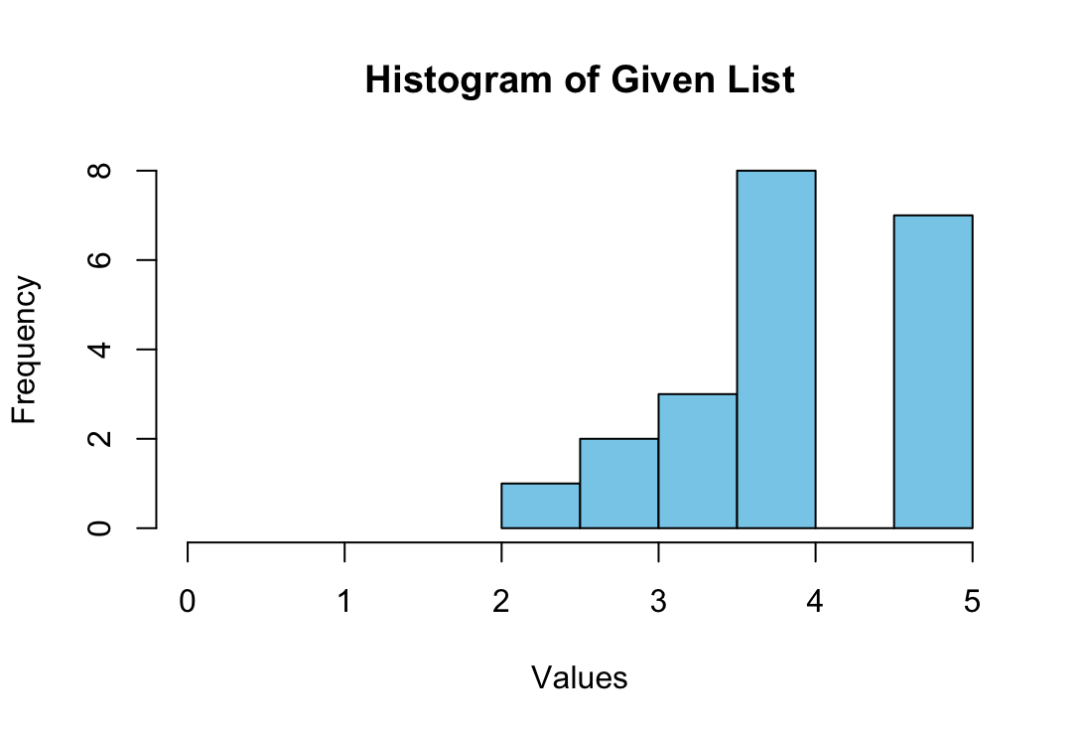
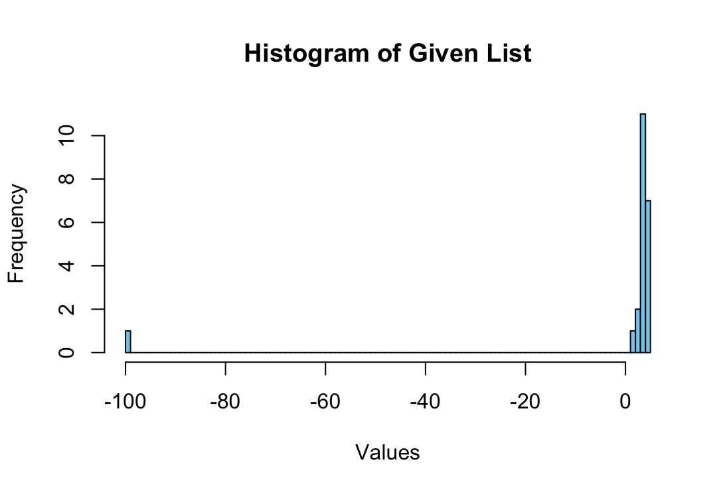
Reading Responses
Mean = -0.66, SD = 22.2
Mean = 4.06, SD = 0.81

Slide 12
Reading Responses
✅ Overall, I think this paper provided a good baseline for diverse design ideas and how technological limitations of the time should not handicap the designer from thinking of diverse designs.
– Rik G.
❌ Dr. Bush perpetuates some concerning stereotypes. [...] "roomful of girls" would manage computer machines perpetuates gender stereotypes [...]
– Carson M.
✅ [...] at the end of WW2 when primary focus was facilitating the war efforts [...] into societal advancements overall is pretty interesting.
– Alekhya K.
❌ [...] did not address the potential societal impacts [...] including privacy, misinformation, or data security. By focusing only on the benefits of information sharing, he missed the potential risks.
– Dewayne B.
Notes:
It is like science fiction - speculative research?
Consider the time when it is created. The societal norms at the time affect the ideas being created. War can induce innovation (but of what kind). We can see some societal norms come negatively in the form of stereotypes.
Lack of safeguards? When you speculate, sometimes you get lost in the sauce.

Slide 13
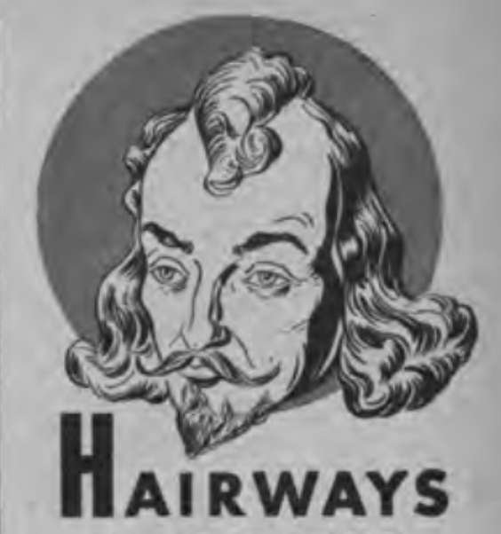
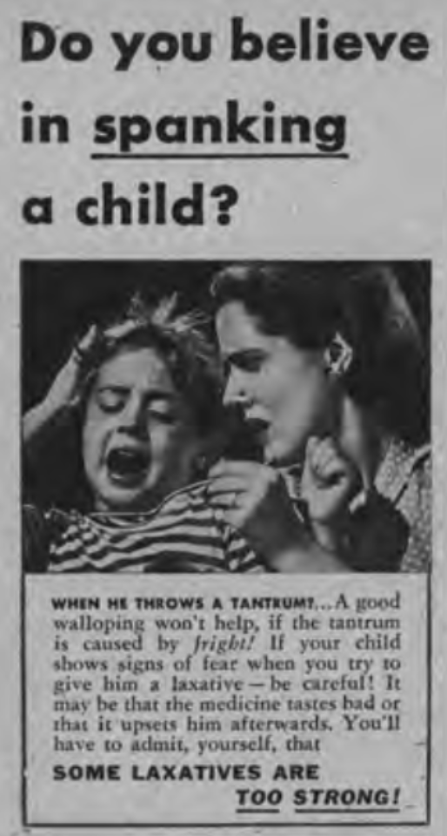
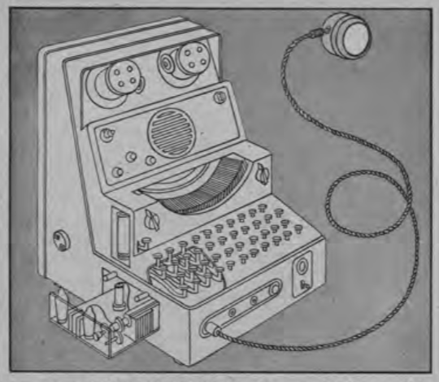
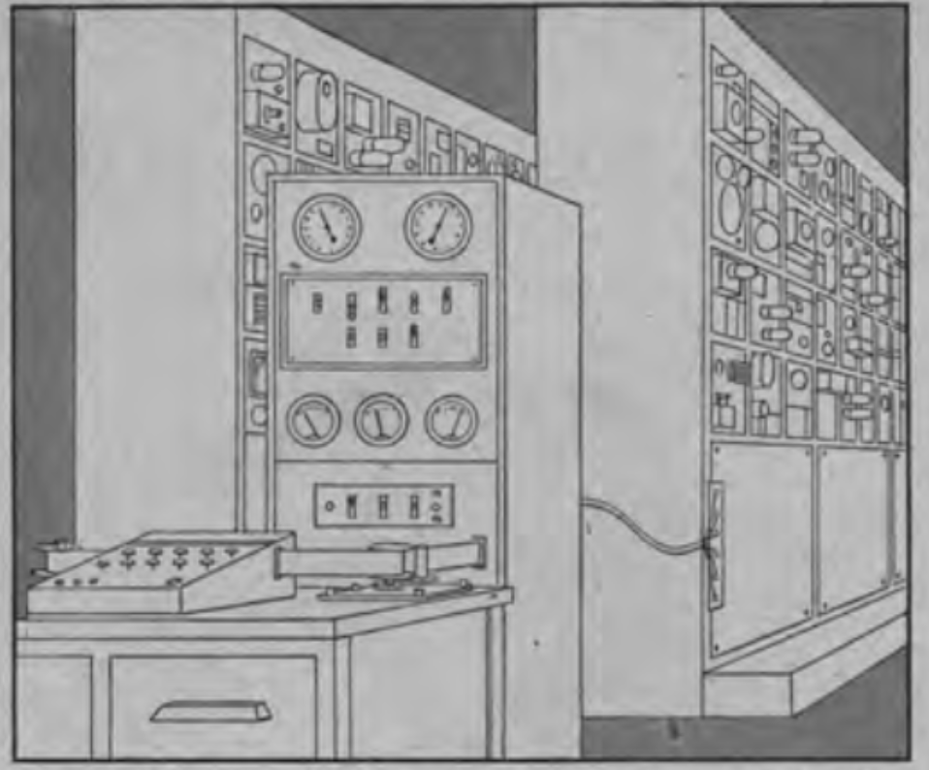
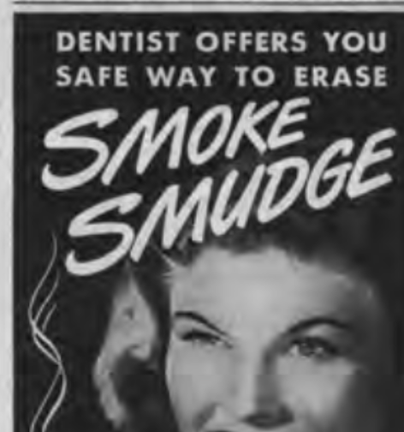
Fantastical Inventions
Some good…
Some (not) so good…
Supersecretary from As We May Think (1945)
Thinking Machines from As We May Think (1945)
Notes:
Vannevar Bush’s article was, in my opinion, ahead of its time. When I talk about fantastical inventions, I’m thinking of things that most people would scoff at because they think it’s unnecessary or unfeasible. This is arguably the most important part of research, the type of paper that inspires.
On the left, we have the part of the Supersecretary, which is like a transcription device. It automatically transcribes spoken words into text. On the right, around the same time this was written, we saw the first public unveiling of computer systems like the ENIAC. The Thinking Machines weren’t so out of the ballpark, and we continue to make general purpose computers that solve equations like sat solvers.

Slide 14
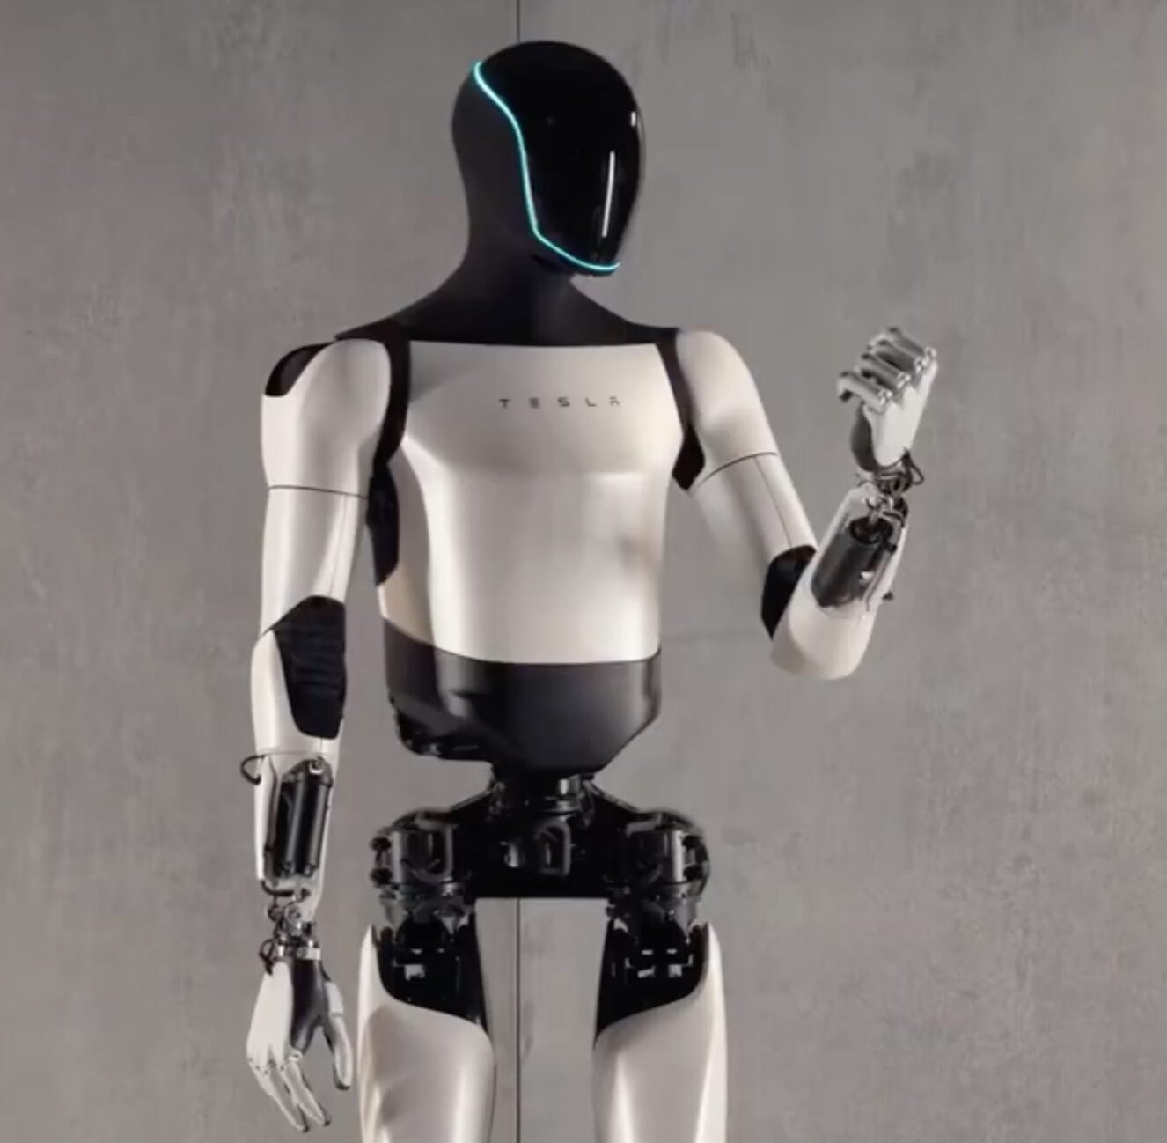
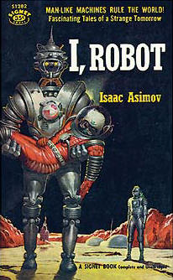
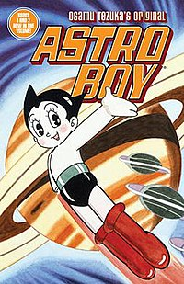
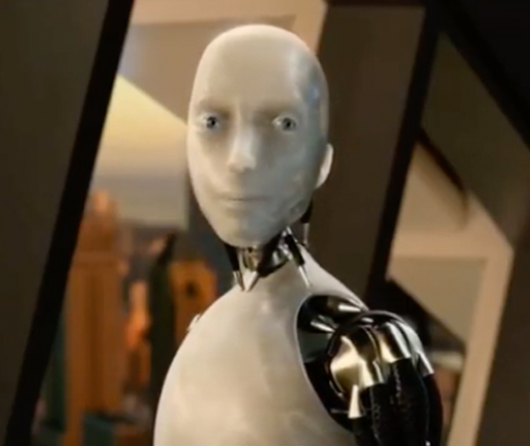
Science Fiction
I, Robot and The Laws of Robotics by Isaac Asimov (1942)
Astro Boy by Osamu Tezuka (1952)
Notes:
Around this time in the 40s, science fiction authors like Isaac Asimov wrote I, Robot, defined the laws of robotics essentially as “Don’t harm humans, obey humans, and protect yourself” in that order. What interests me is that Asimov was already thinking about humans would interact with robotics, a subset of HCI, and these kinds of technologies weren’t even around. In turn, his work likely inspired other engineers, and we can see his influence in media like astro boy, who is a robot and the author Tezuka, has his own laws of robotics.
In the past, they were already thinking about ethical implications for the future. The technology was so far away, but keep this in your mind: it is almost here! We need to have these conversations again!

Slide 15
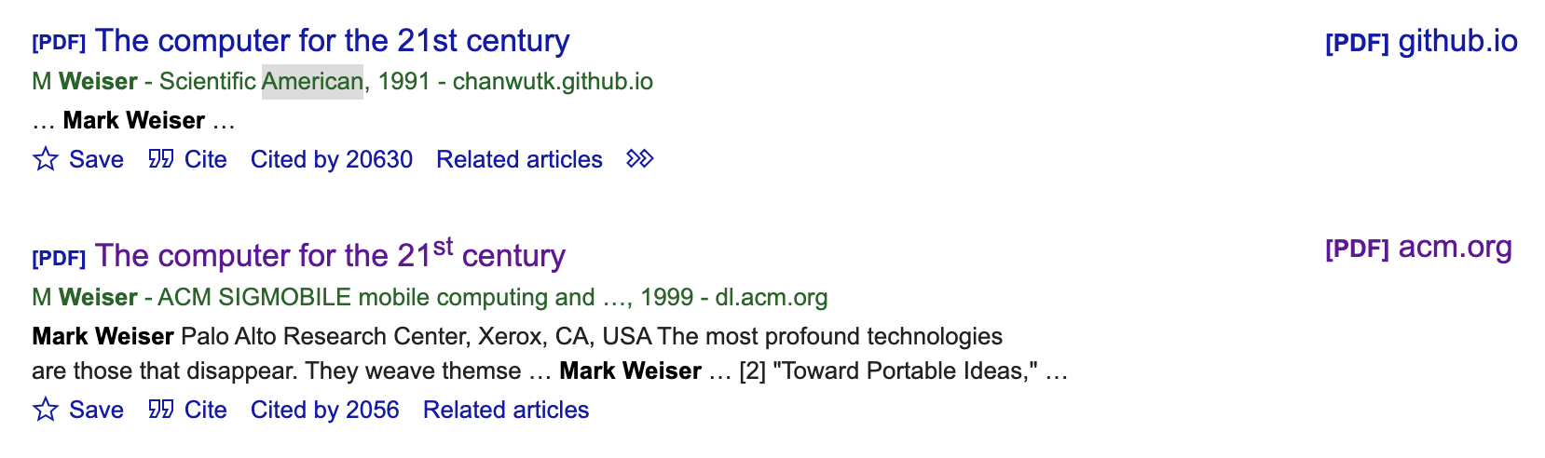
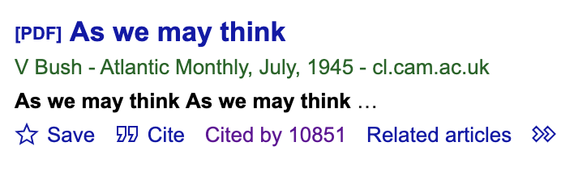

Slide 16
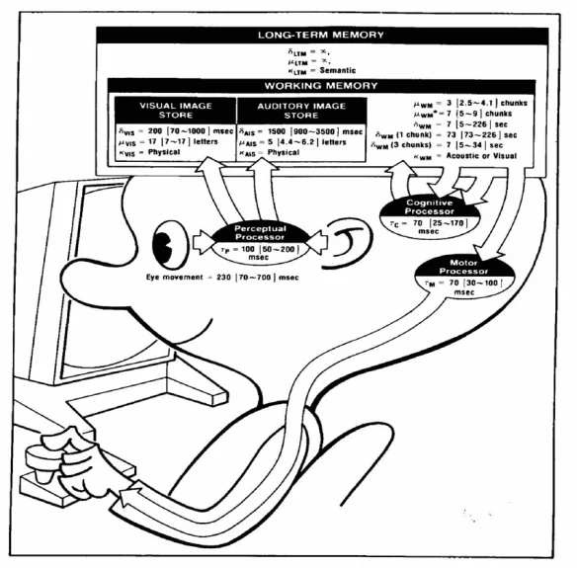
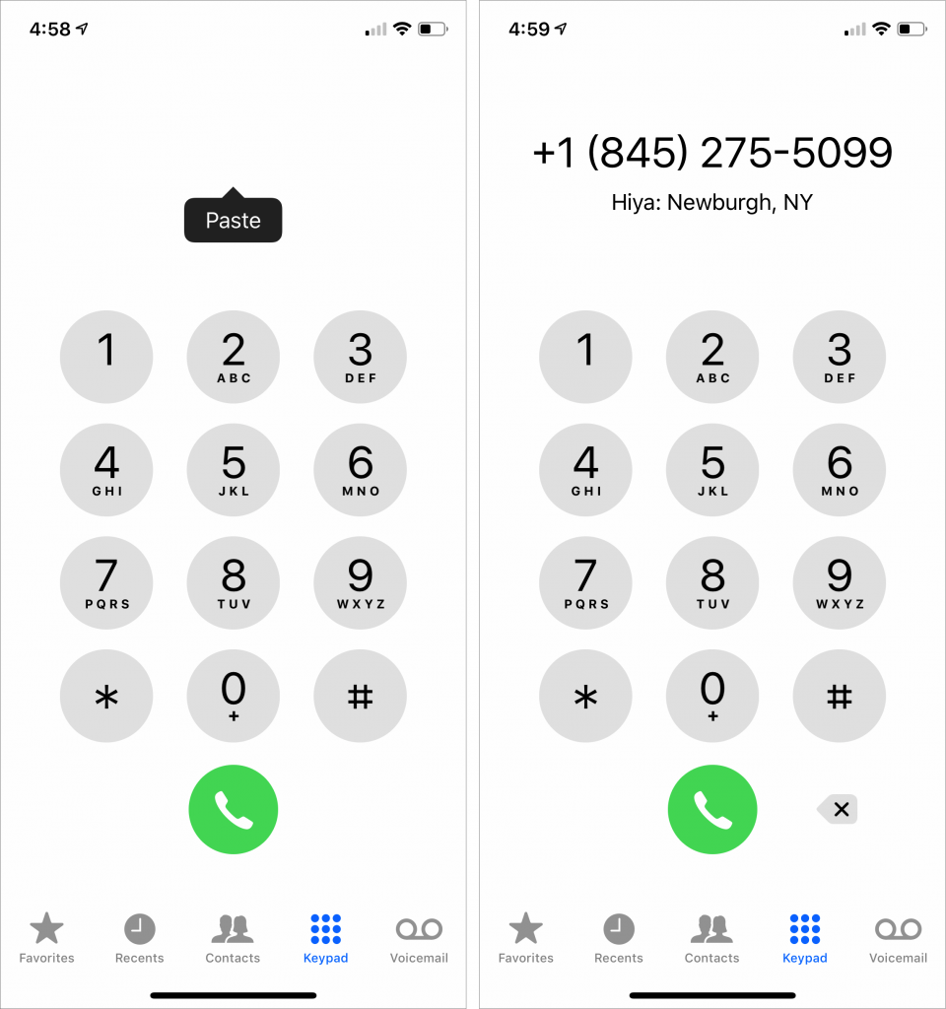
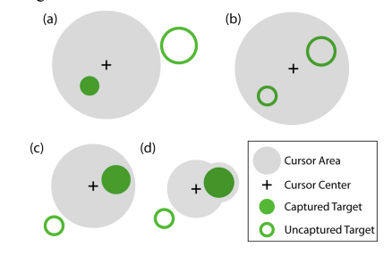
Model Human Processor
Bubble Cursor. Tovi Grossman, Ravin Balakrishnan. CHI 2005
Phone number design. Working Memory Limit
Notes:
Here, we see implications of the model human processor Bubble cursor model’s Fitt’s law, which is how much time it takes to move to and select a target.
Phone numbers measure working memory, which has been measured to be about 7 digits.

Slide 17
The Model Human Processor
Storage Capacity
Decay Time
The amount of visual, mental, and audio storage we can retain.
Can be short-term (fast and limited) or long-term (slow and unlimited (?))
The amount of time data remains relevant in storage. Differs based on long term storage and short term storage.
Code Type
Cycle Time
What kind of information are you receiving.
Acoustic? Tactile? Visual?
How long it takes the mind to process inputs.
Ex: For visual inputs. The information must pass through the eyes, to the mind, and then to the body. Each movement and processing time has a cycle time.
Notes:
The Model Human Processor, was an idea that was created by Card, Moran, and Newell. It involved 4 different characteristics [...]. Now these aspects have been extensively studied, and they are integral in how designers choose how to

Slide 18

Discussion
Are science fiction writings and “fantastical inventions” research?
How has competition in research affected its quality? How does this affect the democratization of knowledge and creating new knowledge?
Notes:
Pros - Google scholar is accessible, a quick repository of data.
Cons - Very elitist, expensive, and ethical problems exist with who has access to technology/who gets experimented on

Slide 19
05
Influence of “As We May Think”

Slide 20
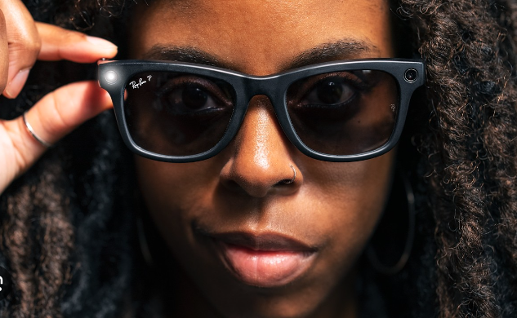
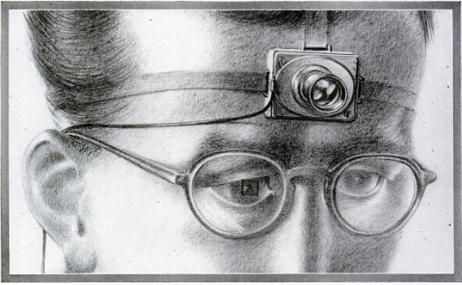
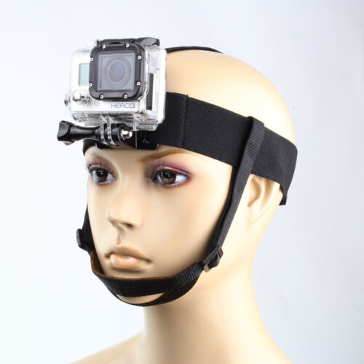
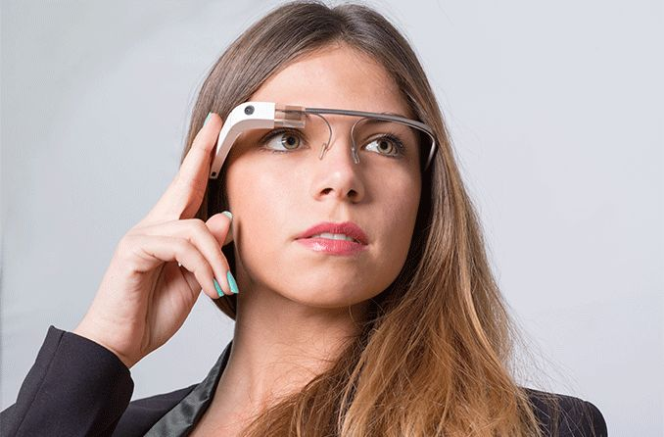
Wearable Tech and Daily Logging
Do you see this idea today?
Notes:
We also have the idea of wearable tech. One of the first ideas mentioned in the paper is this. His idea was a camera that worn on the forehead that takes tiny pictures that can later be projected and enlarged. The user could effortlessly take a picture, while moving around. Today we have means of being able to record data and information exactly like that. Most similarly could be the gopro, that you wear in a similar way, and we also have the invention of smart glasses like Meta Raybans and Google Glass.

Slide 21
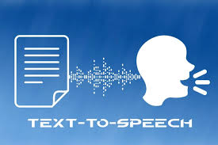
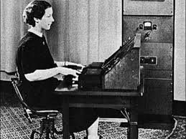
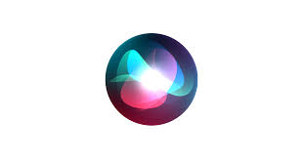
Recognizing Speech
Notes:
He talked about these existing tech at the time. The Voder and Vocoder. Human speech synthesis. He thought it would be cool if machines could not only process information but also communicate in ways that would feel almost natural to humans

Slide 22
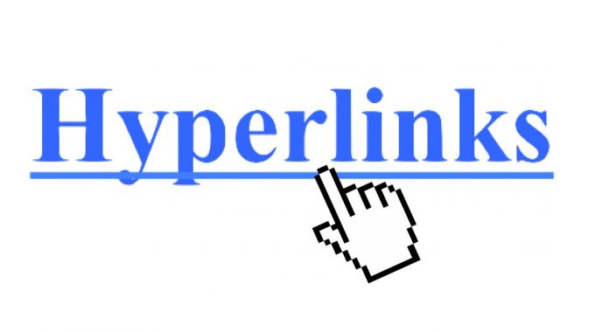
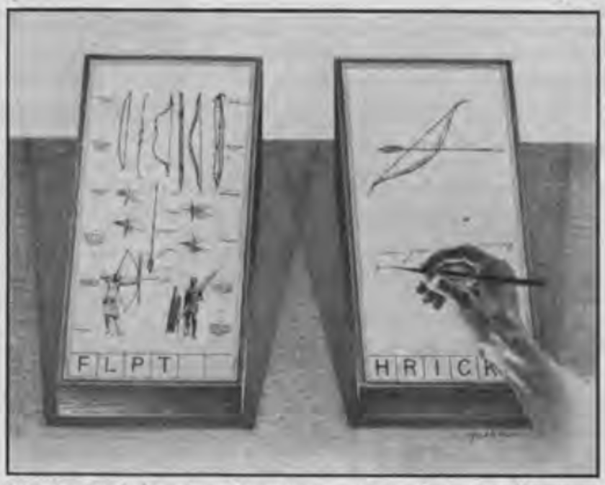
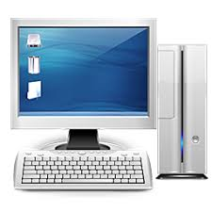
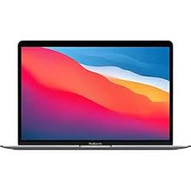
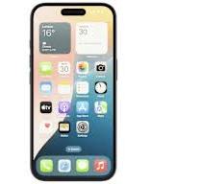

Memex
Memex Interface from As We May Think (1945)
Notes:
One of the biggest ideas in today’s reading was the Memex Interface. Bush imagined it to be a workstation that would allow users to store, organize, and retrieve vast amounts of information. He believed it would make knowledge more accessible. Central to the idea of the memex was its associative linking system, where users could create “trails” that would help them navigate information intuitively, and he believed people would be able to share these trails with others.
This idea has manifested itself in several ways today. For example, we have hyperlinks that enable seamless navigation between related pieces of content across the internet.
We have the personal computer that enables individuals to manage their information and perform complex tasks efficiently.
And we have the World Wide Web, which serves as a vast network of interconnected information accessible to anyone and everyone with an internet connection.
Conclusion

Slide 23
05
Modern HCI
Notes:
Now let’s take a look at Modern HCI.

Slide 24
Discussion
What are the goals of modern HCI, and how are they similar or different from the goals of HCI in the past?
Notes:
Early HCI goals focused primarily on efficiency, usability, and performance. These goals are very important and are still present today, but with changing technologies and changing societal concerns, we now have a lot more goals.

Slide 25
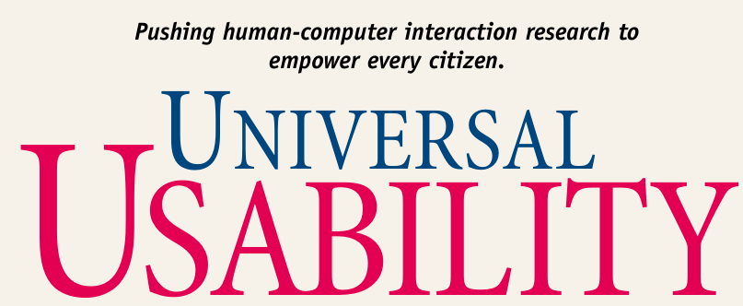
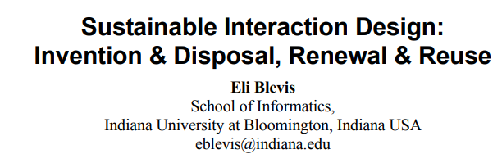
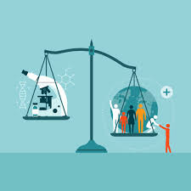



Modern HCI Goals
Inclusion and Accessibility
Sustainability
Privacy and Ethics
Notes:
Here are a few modern HCI goals,
There’s Inclusion and Accessibility. We need to consider how to make computers work well for people of all types. This means designing interfaces that accommodate various abilities, languages, and cultural backgrounds. There was an influential paper published in 2000 named “Universal Usability”, and it explored the fact that there really isnt an “average” user. We’re all different. The idea is to go beyond traditional accessibility and instead create inclusive designs that adapt to varying user needs and contexts
Next, we have Sustainability: how do we ensure that our technological advancements do not come at the expense of our planet? What impact does our design and production have on the environment? Here’s a paper that I found interesting that considers how technology affects the environment across its entire lifecycle, from production to usage and disposal.
There’s privacy and ethics: What measures can we take to give users control over their data, in order to provide transparency and trust? What strategies can we implement to make certain that our designs are inclusive and fair, considering the diverse perspectives and experiences of different users?
So we use these goals to enhance and evaluate both old and modern technologies.

Slide 26
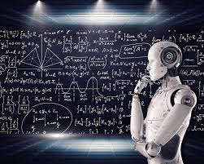
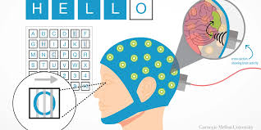
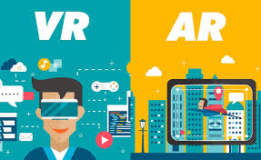
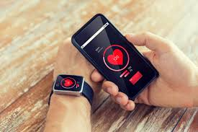
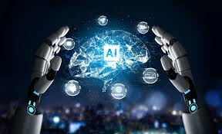
Modern Technologies
Notes:
Today we have a lot of new technology. AR/VR, ML and AI, BCI, Wearables…., and a lot of them have shown to have several benefit.

Slide 27

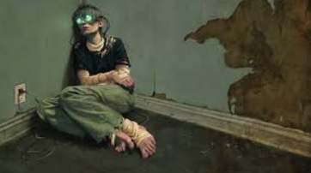
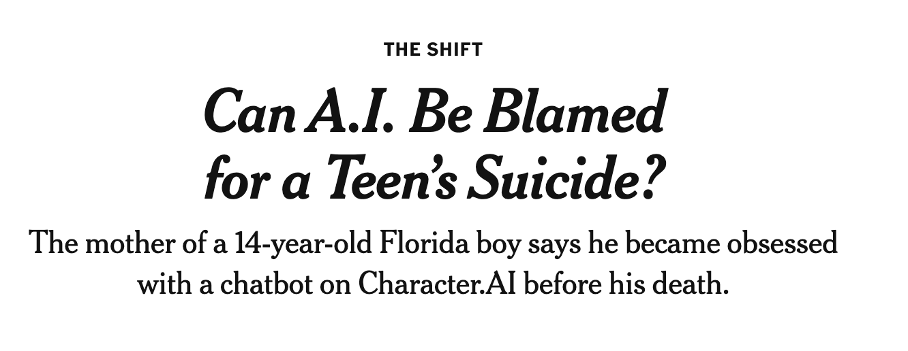
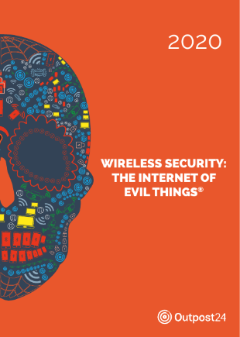
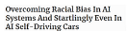
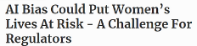
Rising Concerns
How can we design AI and emerging tech in a way that minimizes these unintended negative impacts?
How do you think we can balance innovation with safeguards to protect users?
Notes:
But the downsides of them are more apparent and detrimental than ever before. Some people ruin a good thing, by using technology in malicious ways. But not all of these issues are as a result of people misusing or mistreating a system. For example, AI categorization errors can have harmful consequences. People are getting stuck in VR, and are becoming addicted to it. These questions might be a bit more difficult, but * Read Questions*

Slide 28
06
The Future

Slide 29
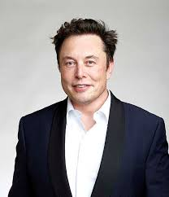
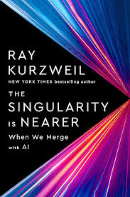
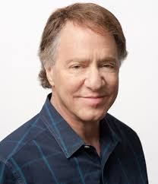
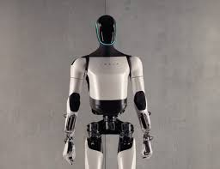
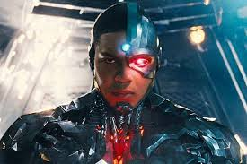
People’s Ideas for the Future
Notes:
Many people are making technological predictions for the future just like Vannevar Bush did many years ago.
Ray Kurzweil's has this idea of the “singularity”, where he envisioned a future where AI surpasses human intelligence. He also thinks there will be human-computer integration, where people can enhance their physical and mental abilities by merging with technology.
We also have Elon Musk , who envisions a future where humanoid robots play a significant role in everyday life by reducing human involvement in tedious activities.

Slide 30
Discussion
What are some technologies that you think we will have in the future or that you hope to see?
How will these technologies change the goals and definition of HCI?

